Slide 1
Computer ON FPGA
Faculty Guide :Shubhajit Roy Chowdhury
Students : Jashwanth
Lokesh

Slide 2
NIOS II Processor
Initial problems:
Altera Debug client
Qsys integration
HAL ( hardware Abstraction layer)
The HAL is a lightweight embedded runtime environment that provides a simple device driver interface for programs to connect to the underlying hardware. The HAL
application program interface (API) is integrated with the ANSI C standard library.
Demonstrate simple io model processor

Slide 3
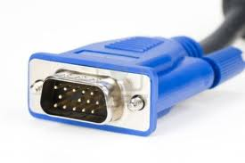
VGA Interface
Coded for VGA interface and synced simple RGB data to the monitor
VGA_HS,
VGA_VS
VGA_R,
VGA_G,
VGA_B

Slide 4
How to code
VGA pattern
I used a reset button to reset screen when key is pressed.
Else default image is white.
Based on switch Red , Blue, Green screens are generated.
i.e., ored <= 1023;
oblue <= 0;
ogreen <= 0;

Slide 5
………
VGA Controller
Serial scheme for coloring
Hsync signal is asserted low to tell the monitor to move to the next horizontal row of pixels
The vertical cycle allows the monitor to synchronize which rows are being written by the horizontal cycles.
The vsync signal tells the monitor to go back to the (0,0) pixel

Slide 6
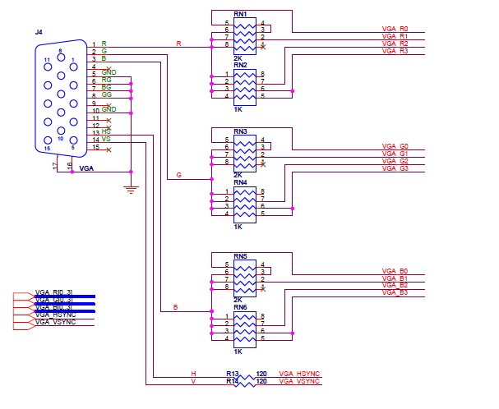
Courtesy : Altera

Slide 7
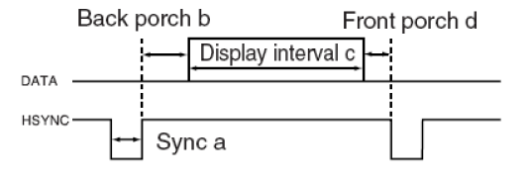
96,48,640,16 = 800 pulses
Hsync generation
Vsync generation
Address and coordinate generation

Slide 8
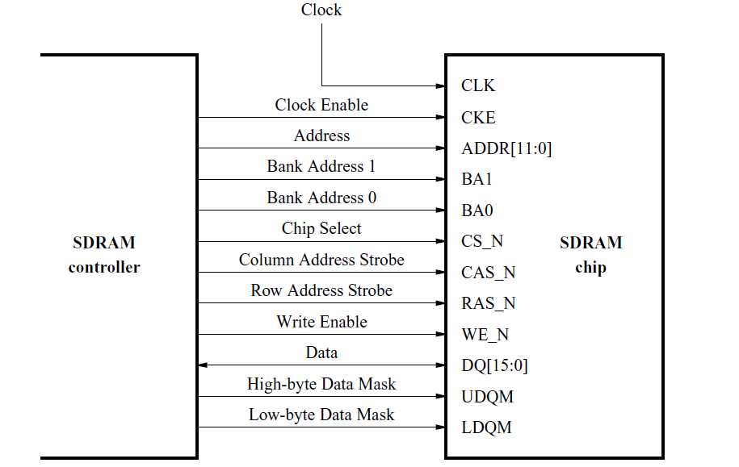
SDRAM interface

Slide 9
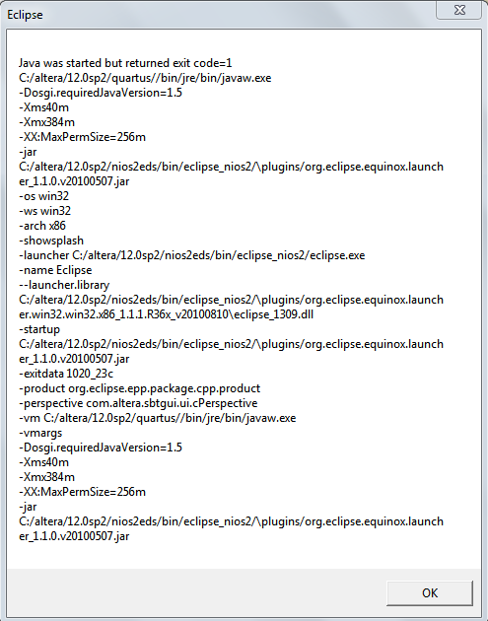
SRAM,FLASH,SDRAM,ON-CHIP

